Slide 1
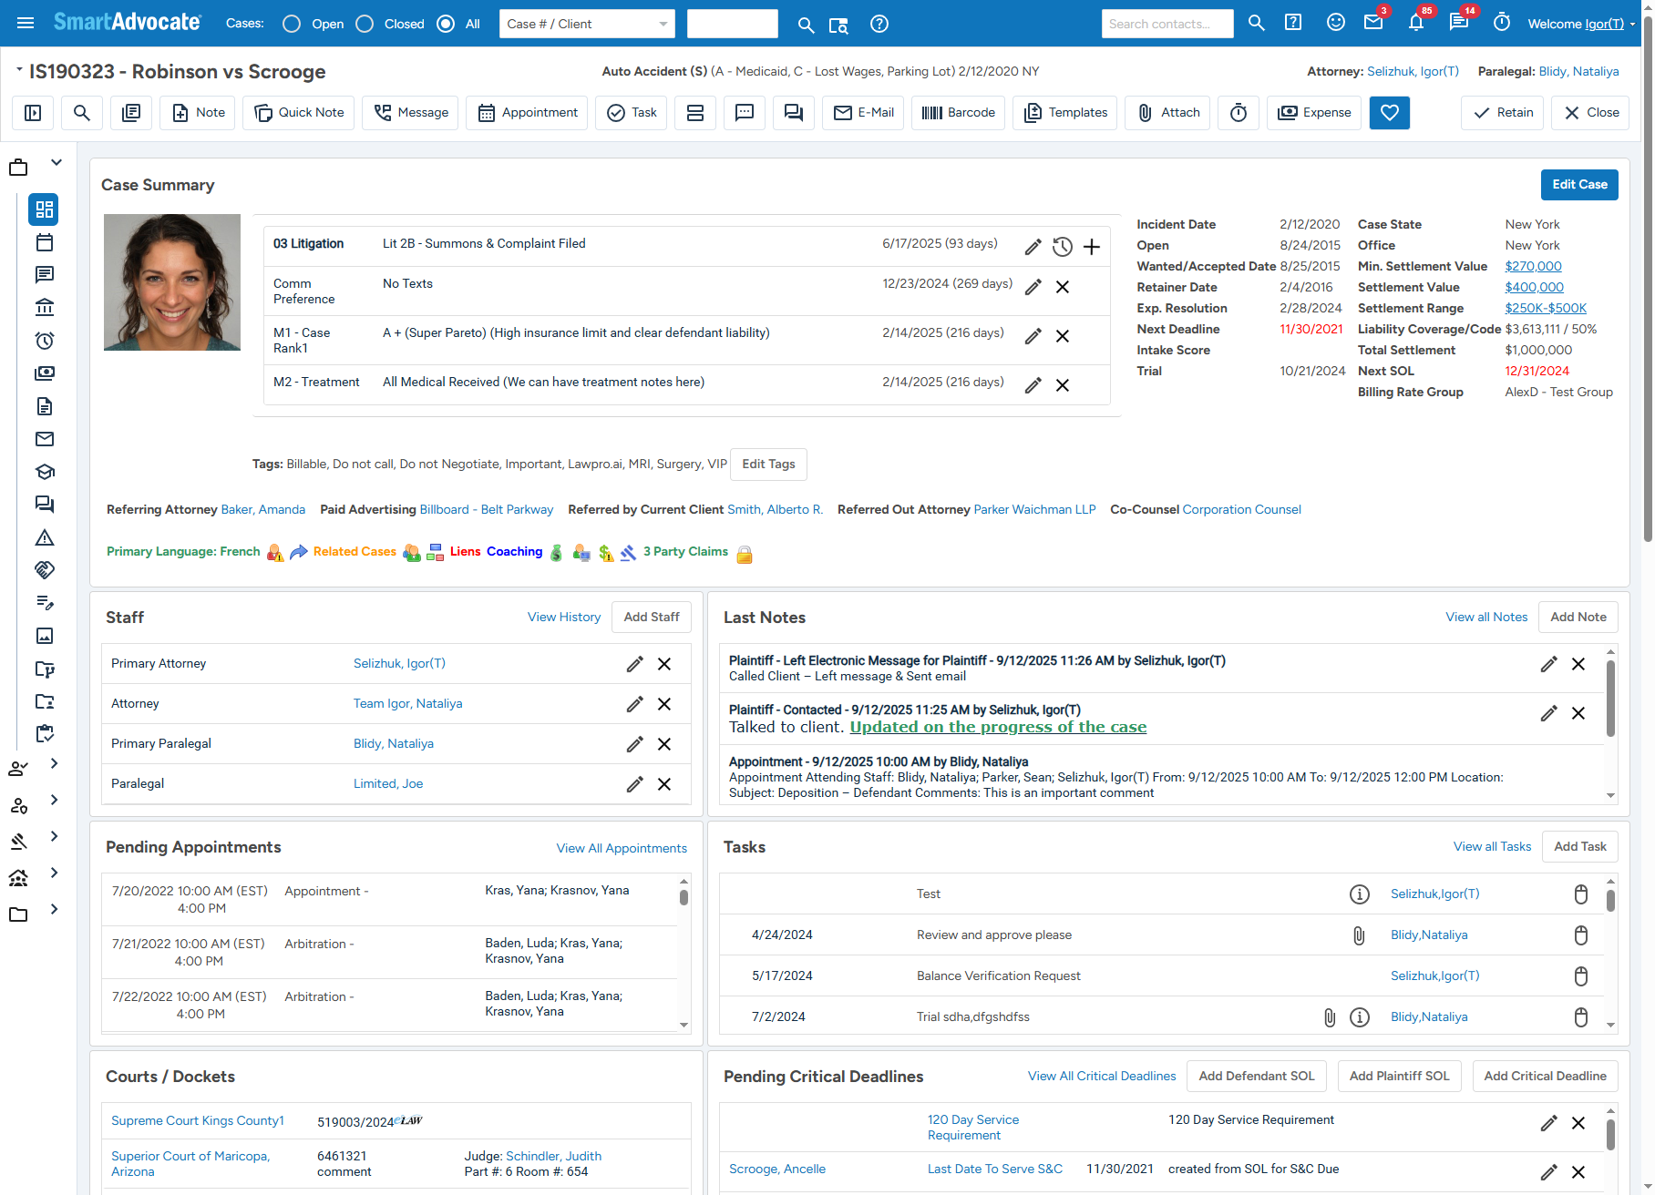

2025 Release Tech Talk
Your Headshot
Igor Selizhuk
Chief Technology Officer

Slide 2
New Functionality
  AI Tools Enhancements/Additions
    Multi-document Summary
    Automatic Document Properties Population (Category/From/Description)
    AI Case Chat
  Billing/Invoicing for Transactional Cases
  Accounting Module to be Released at the End of the Year

Slide 3
New Functionality
  Audio Playback in the Browser
  UDF Grids
  UDF tab for Contact Cards
  UDF Grid tab for Contact Cards
  Disbursements/Expenses CSV Import
  Document Folder Upload

Slide 4
New Functionality (UI/UX)
  New Default Display Theme
  Ability to Customize Labels by Case Group/Type
  Ability to Customize Case Toolbar
  Recent Documents (Global and per Case)
  Case Menu Search
  Improved Folder View
  SmartMetrics Dashboards New Navigation
  Date Calculator

Slide 5
Billing/Invoicing for Transactional Cases
  Invoice Generation/Approval/Distribution
  Client Trusts
  Client Payments
  Stored Payment Methods
  Rate Tables
  Rate Overrides
  Mass Operations for Invoice Generation, Approval, Distribution
  Mass Operations Card Charges and Trust Pull

Slide 6
Release Schedule
  9/23 – Branch and build beta version (release candidate)
  9/23 – 9/27 – Upgrade existing beta clients to release candidate
  9/23 – 10/10 – Upgrade some of the server clients to release candidate
  10/15 – New Release Presentation at SmartAdvocate Connect
  10/20 – New Release Webinar, new version is declared officially released and available for server clients
  11/01 – Main Cloud upgrade. Maybe separate Oracle upgrade from Liquid Web upgrade.

Slide 7
Accounting is Being Release by the End of the Year
  Build from scratch and is part of SmartAdvocate
  Fully Integrated
  Information can be entered in Cases or in Accounting module
  Invoices can be linked to Vendors entered in SmartAdvocate
  Settlement checks can be linked to Settlements
  Currently being used by one client

Slide 8
THANK YOU!

